Slide 1

Coin Recognition Using MATLAB
The Presentation
Submitted in partial fulfillment of the requirement
for the award of the degree of
Bachelor in Engineering
Submitted By
Himanshu Sharma
(1810991774)
Jasleen Randhawa
(1810991776)
Suryansh Gupta
(1810991788)
Department of Computer Science & Engineering
Chitkara University Institute of Engineering and Technology
Chitkara University, Punjab-140401
India
November - 2019

Slide 2
Computer Vision
Image processing is a precursor to Computer Vision – making a computer understand and interpret what’s in an image or video.
3D shape
Robotics
Recognition
Tracking
Categorisation / Retrieval
Segmentation

Slide 3
Introduction
Using digital image processing it’s possible to obtain the most accurate method by reading the details of an obtained photo to compare it with the properties of another standard photo.

Slide 4
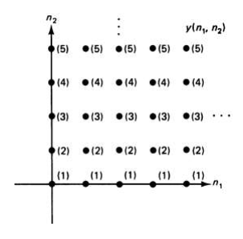
Digital Image Processing
Digital image processing method depends on two dimensional Fourier transform so the obtained samples of the photo would be formed in a two dimensional array as in the following

Slide 5
The method of digital image processing done by taking a finite number of samples whatever the scale of the photo so it’s possible to control the accuracy of a digital image by increasing or decreasing the number of samples (pixels).
The method of digital image processing done by taking a finite number of samples whatever the scale of the photo so it’s possible to control the accuracy of a digital image by increasing or decreasing the number of samples (pixels).
The method of digital image processing done by taking a finite number of samples whatever the scale of the photo so it’s possible to control the accuracy of a digital image by increasing or decreasing the number of samples (pixels).
Each pixel would has two properties:
1. The intensity: which relates to the amount of light or the numerical
value of a pixel;
2. Location address: the location of a pixel within the array of pixels
(samples)
The method of digital image processing done by taking a finite number of samples whatever the scale of the photo so it’s possible to control the accuracy of a digital image by increasing or decreasing the number of samples (pixels).

Slide 6
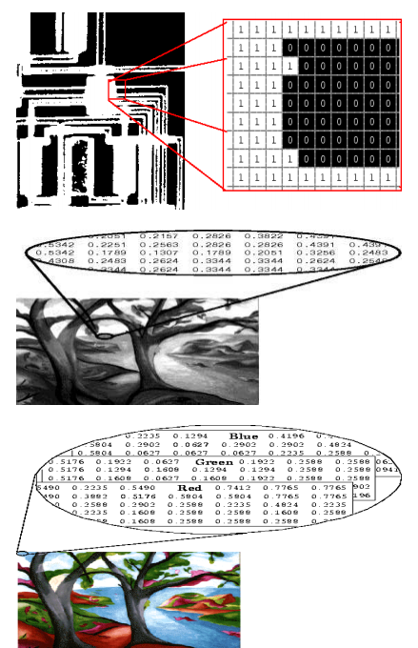
Types of Digital Images:
Binary:
Each pixel is just black or white.
• Gray scale:
Each pixel is a shade of gray.
• True Color, or RGB:
Each pixel has a particular color.
This color is described by the amount of red,
green and blue in it.
Each has range of (0-255)

Slide 7
Coin identifier using Digital image processing
using MATLAB
Image processing: is a method to perform some operations on an image, in order to get an enhanced image or to extract some useful information from it.
Objective: The main purpose of this project is to apply edge detection techniques to develop a program which should recognize coins in an image.
We have used Hugh Transform for coin detection.

Slide 8
Need for coin detection-
There is a basic need to automate the counting and sorting of the coins. For this machines need to recognize the coins very fast and accurately as further processing depends on this recognition.
The main purpose of this project is to apply computer vision techniques to develop a program which should recognize coins in an image, and enumerate their value. That is to have a computer read the image.

Slide 9
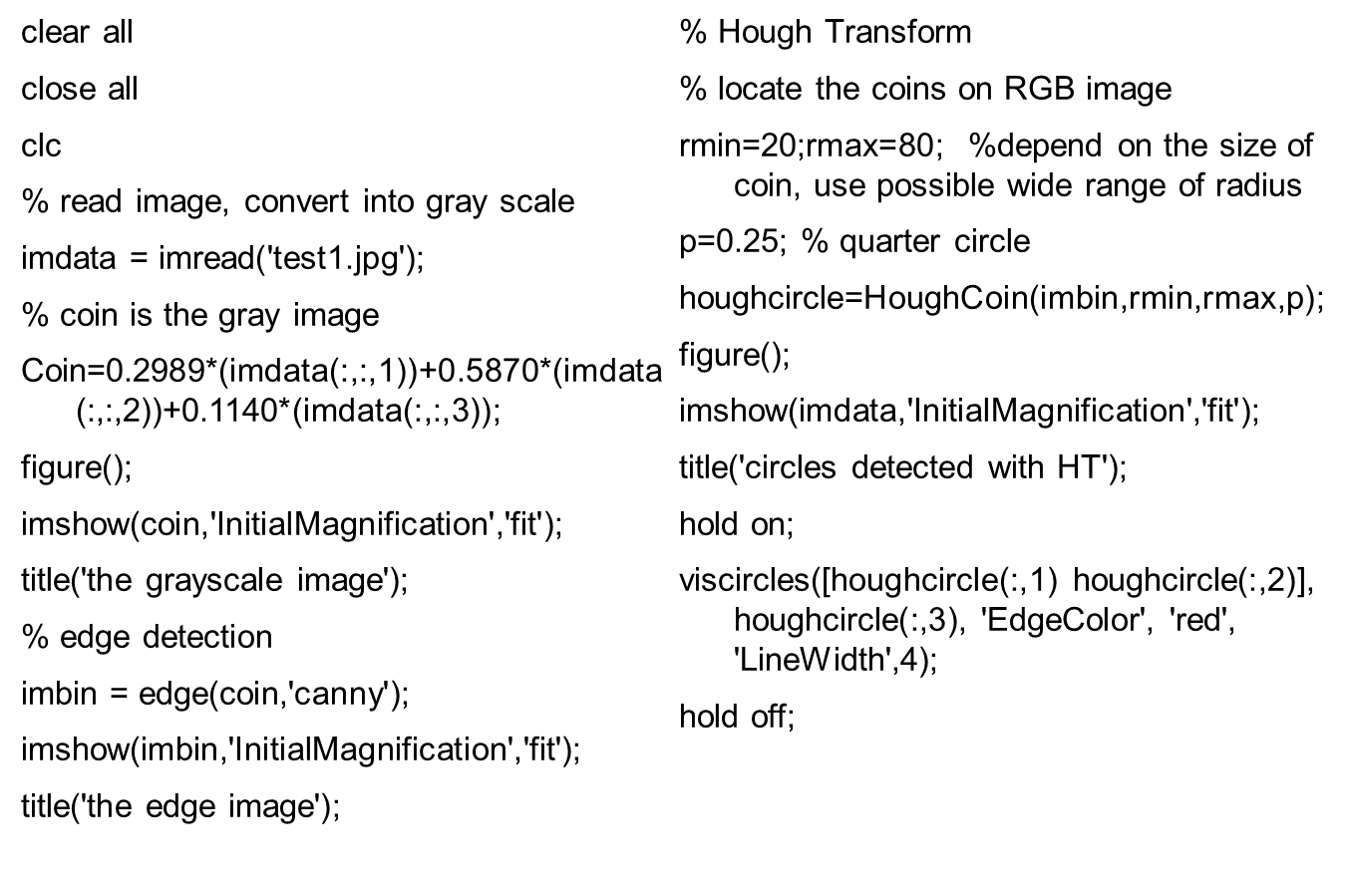
Code:

Slide 10
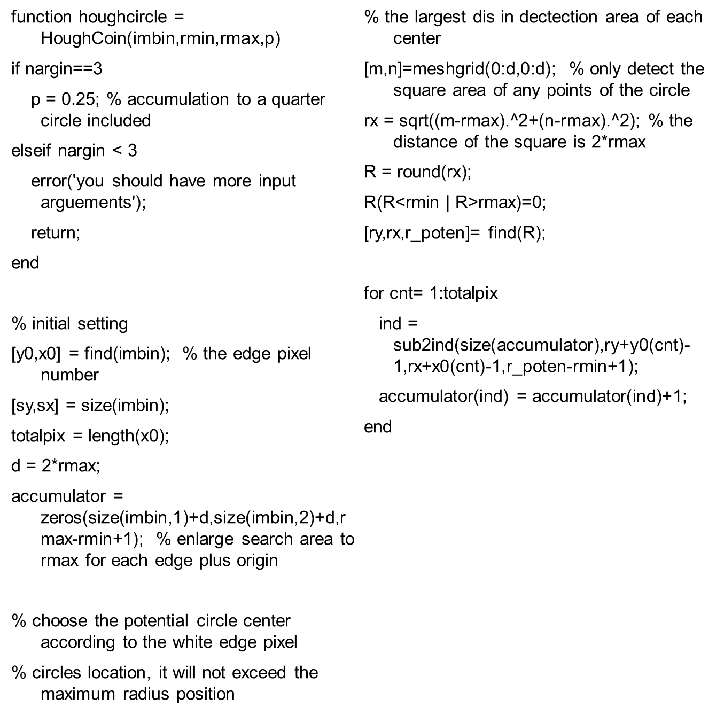
Hugh Transform function

Slide 11
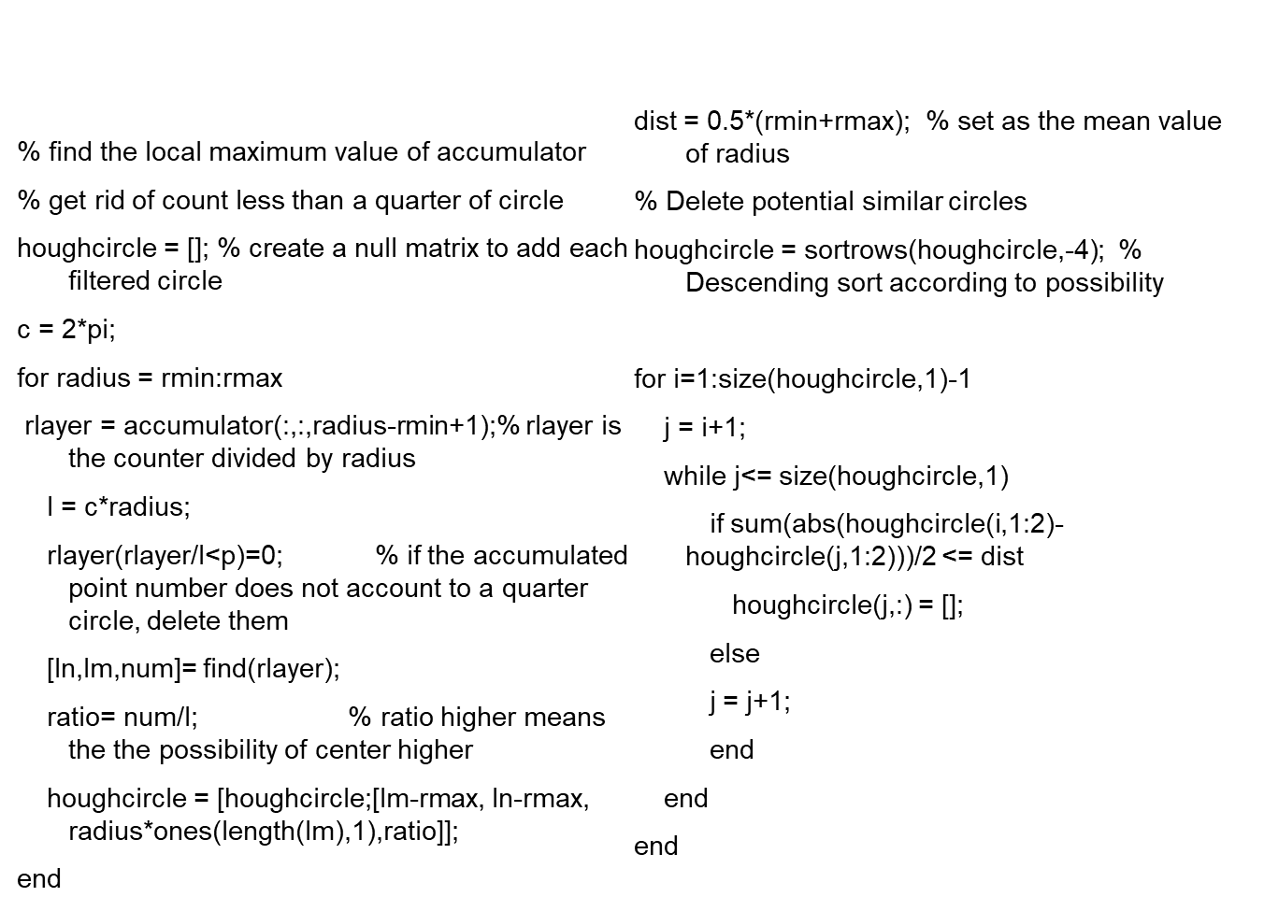

Slide 12
The following steps are taken in the proposed coin recognition system:
Step 1: Develop RGB code for loading database of coin image in MATLAB.
Step 2: Convert this RGB image to grayscale Image using MATLAB.
Step 3: Applied Image Thresholding on Gray Image in MATLAB.
Step 4: Crop the coin image automatically in MATLAB.
Step 5: Detection of the Edge of Image in MATLAB.
Step 6: Recognize the coin using its centroid and radius.

Slide 13
Convert RGB Coin Image to Grayscale
From the first step the image we got the 24-bit RGB coin image. The figure below shows the grayscale converted image in given RGB image of the coin.
Edge enhancement
In order to improve the accuracy of Hough Transform, the clear edges of the coins were required. In other words, edge enhancement was required.

Slide 14
Edge detection
We can use either Sobel or Canny filter to detect the edges but Canny is preferred as it reduces the noise in the image more than Sobel.
Centroid Measurement
Next, we use The Hough Transform to calculate the radius of the image and detect its centroid.
Coin Recognition
Finally we can use the computed radius to compare with given data and recognize the coin.

Slide 15
Edge Detection
There are many algorithms to process a photo, edge detection is one of
simplest methods which depends on significant changes like color or
some physical aspects.

Slide 16
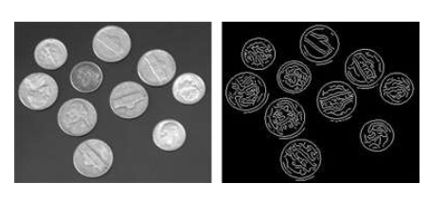
The simple meaning of edge detection is to transform a photo into set of curves; the curves are the boundaries which split the significant changes so some properties of the photo could be treated.

Slide 17
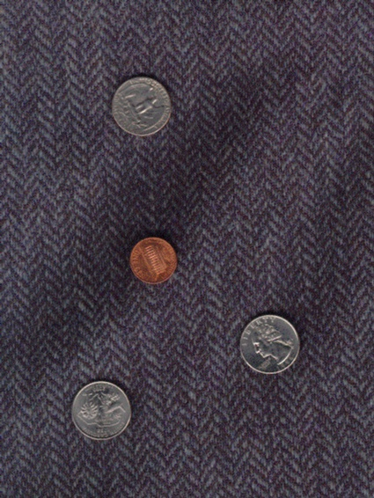
Original
Image

Slide 18
Sobel Filter
If Sobel filter is used to a coin image, large number of edge points are obtained.
The texture of the coin can be regarded as noise, which will induce a huge overhead in the execution time of the Hough transform and most importantly will produce measurement errors.
Therefore, the technique to reduce the unwanted edge is sought.

Slide 19
Canny Filter
The canny edge detector is a very powerful tool for detecting edges in a noisy environment. Canny edge detector can remove most of the edge points. Canny gives thin edges compared to the Sobel. Hence, canny edge detector has been used for eliminating the unwanted edges that can result from Sobel.
The result of this edge detector is a binary image in which the white pixels closely approximate the true edges of the original image.

Slide 20
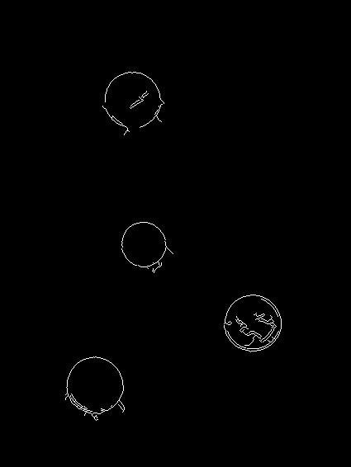
Edge Detection
using
Canny
Filter

Slide 21
Hough Transform
It is an elegant method for direct object recognition as the edges need not be connected and the complete object need not be visible.
It works on disconnected edges and can effectively detect lines, circle, and simple shapes

Slide 22
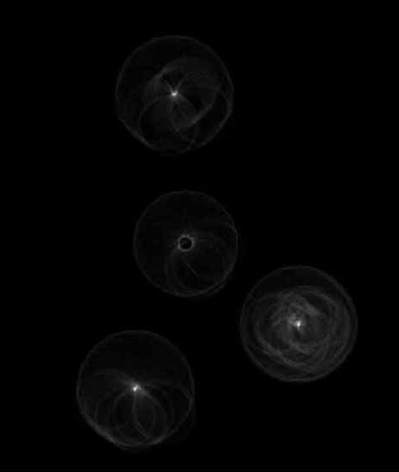
Finding
Circle
using
Hough
Transform

Slide 23
Detecting Circles
Once the hough transform image for a particular radius is computed to leave only those points with high probability of being the centers
The centroids of each region are considered as centers of the detected coins.
The output image is computed by drawing circles with these points as centers and the matched radius as the radius, and adding this to the input image.

Slide 24
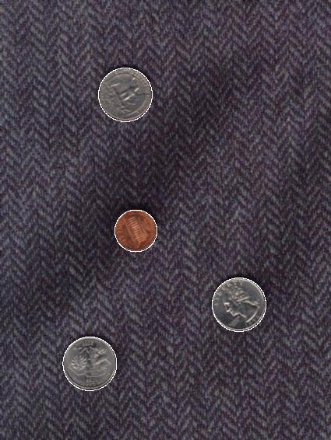
Recognized
Coins

Slide 25
Conclusion
The proposed system can be used in coin operated payphones, vending machines, weighing machines and in many other machines that are based on coin recognition.
The problem arises if the coin image is captured from a distance and the image tends to be small. Besides that, some of the coins are overlapped. These restrictions make the detection process difficult.

Slide 26
Thank You

